Slide 1

A Project Presentation on IoT Based Water Level Monitoring and Alert System
Presented By:
Rajan Kumar
Aniket Kumar
Bhupendra Singh
JIET, ECE (4th Year)
Guided By:
Prof. Avanish Bora

Slide 2
CONTENTS
Introduction
Objective
Model
Required Equipment
System Architecture
Coding
Result
System Installation
Advantages
Future Enhancements
Conclusion
References

Slide 3

Introduction
Globally, millions of gallons of water are wasted every day due to inefficient water management systems.
According to the Times of India, people waste around 125 million liters of water daily due to water storage tanks overflowing.

Slide 4
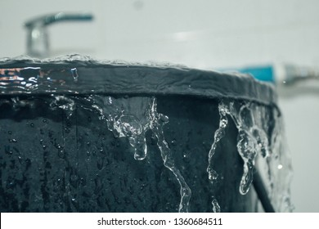
Objective
Real-time Monitoring
Early Warning System
Remote Accessibility
Importance of Achieving Objectives in Water Management
IoT-based solutions offer a cost-effective and scalable approach to water level monitoring, enabling remote accessibility and data-driven decision-making.
Prevention of property damage due to overflow incidents.
Sustainable management of water supply networks.

Slide 5
System Design

Slide 6
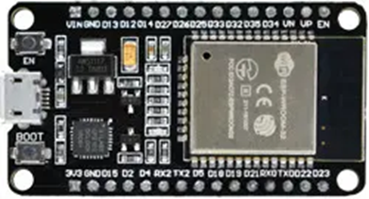
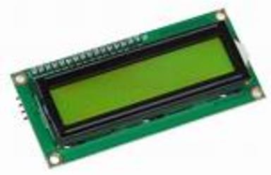
Required Equipment
Esp32 Microcontroller Board
Waterproof Ultrasonic Sensor (HC-05)
LCD Display (16x2) with I2C adaptor
Connecting Wires
Indicating LEDs
Frame Structure for Setup the System
Power Supply ( 5 V, 1 Amp.)

Slide 7
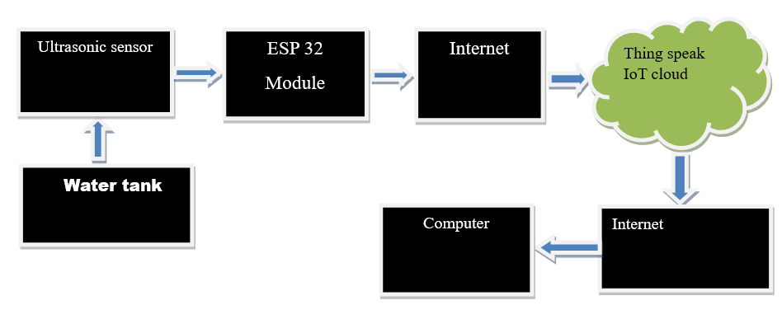
System Architecture

Slide 8
Coding
https://github.com/RAJA0504/Final-Year-Project-2024

Slide 9
Result

Slide 10
System Installation

Slide 11
Advantages
Early Detection of Water Level Changes
Remote Monitoring Capability
Data Analysis for Decision Making

Slide 12
Future Enhancements
Potential Improvements and Upgrades
Integration with Other IoT Devices
Expansion to Multiple Monitoring Points

Slide 13
Conclusion
Our project demonstrates the effectiveness of an IoT-based water level monitoring and alert system in addressing the challenges of inefficient water management.
Successful implementation of a system capable of continuous monitoring and remote accessibility.
Our project underscores the importance of proactive measures in water management to mitigate wastage and ensure the sustainable use of this precious resource.
By harnessing the power of IoT, we have laid the foundation for smarter and more resilient water management systems that can adapt to the challenges of the future.

Slide 14
References
https://neerain.com/49-billion-liters-of-water-is-wasted-daily-in-the-country-due-to-carelessness/
https://timesofindia.indiatimes.com/gadgets-news/flosenso-best-automatic-water-level-controller-from-energybots-for-smart-homes/articleshow/105359383.cms
https://www.thehindu.com/news/cities/Madurai/overhead-tank-overflows-at-a-time-of-water-crisis/article28190100.ece

Slide 15



Thank You

